Slide 1
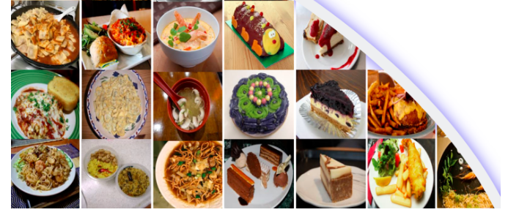
Group 2
Food recognition and calorie estimation with various pretrained models and Stacked Global-Local Attention Network (SGLANet).
Aman Bawa
Huazheng Zhang
Ravleen Kaur Dehiya
Professor: Dr. Franzke
Mentor: Digbalay

Slide 2
Cotent
Objectives
Actions
Challenges
Results
Conclusions
References

Slide 3
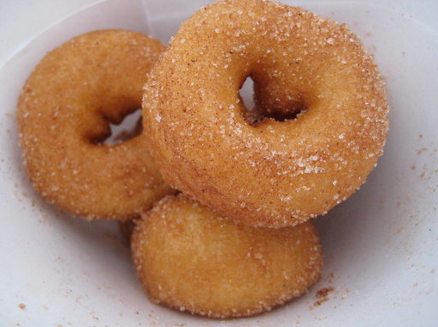
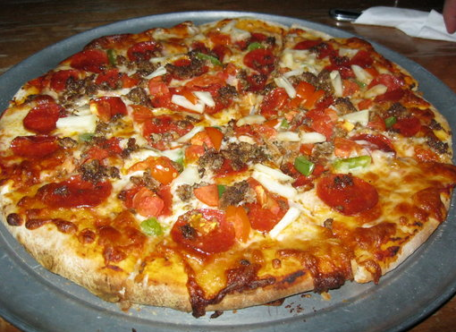
Objectives
Input
Output
Donuts
Model
Piazza

Slide 4
Actions
Outline:
(pipeline graph better in here)

Slide 5
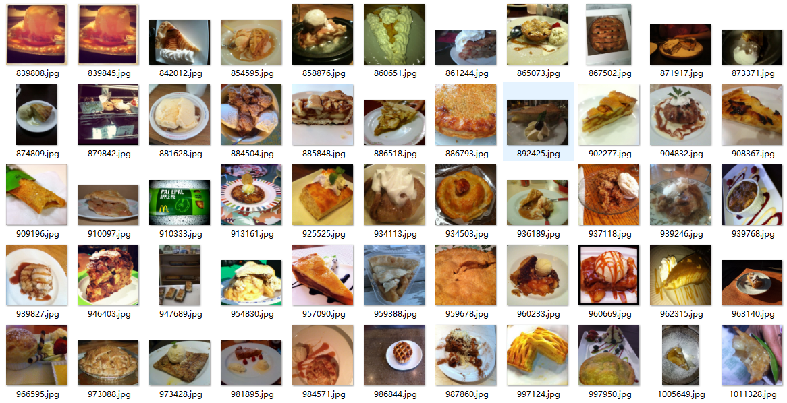
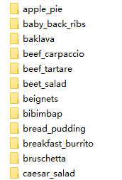
Actions Data
Each class has 1000 images for the same food
101 food classes
https://www.kaggle.com/search?q=food

Slide 6
Actions Data
Resize
(255,255,3)
Data
Clean
ToTensor
Dataloader
Label
Train set/ Validation = 8/2

Slide 7
Actions Model

Slide 8
Actions Training

Slide 9
Actions

Slide 10
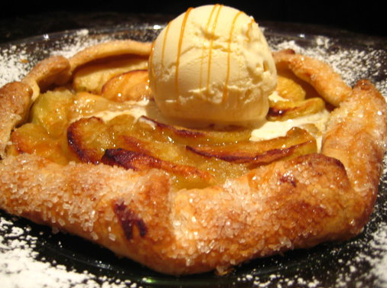
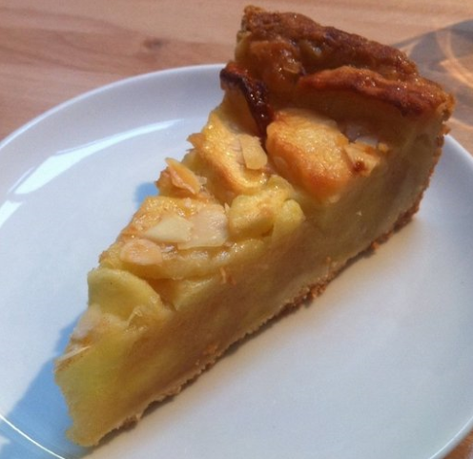
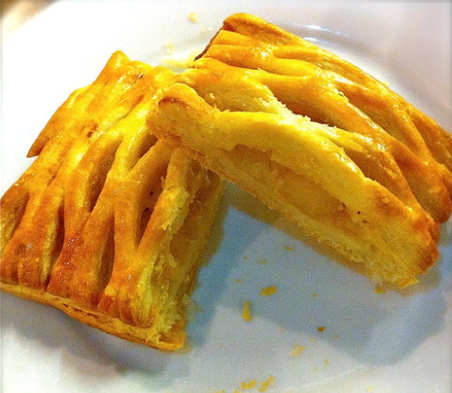
Challenges
As following
They are all apple pie, but the shape and features are very different.

Slide 11
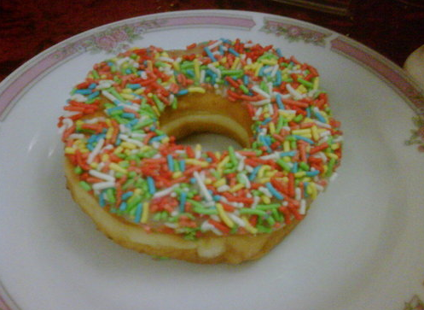
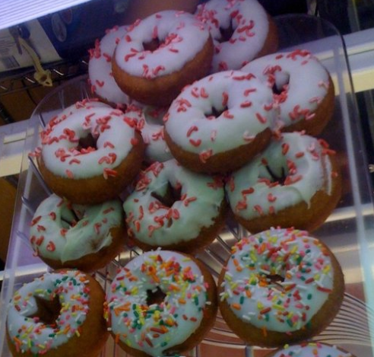
Challenges
As following
They are all Donuts, but one picture only has one, another has multiple donuts

Slide 12
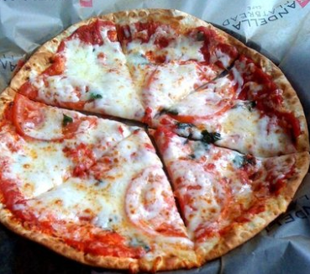
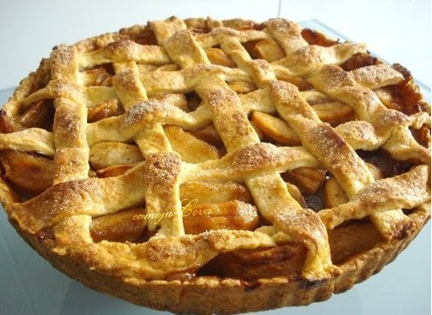
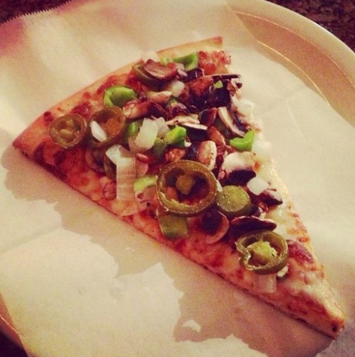
Challenges
As following
Even the shape are similar, they are totally different food
Piazza
Apple pie
Piazza
Apple pie

Slide 13
Results

Slide 14
Results

Slide 15
Conclusions

Slide 16
Reference
OMin, Weiqing, et al. "ISIA Food-500: A Dataset for Large-Scale Food Recognition via Stacked Global-Local Attention Network." Proceedings of the 28th ACM International Conference on Multimedia. 2020
Shen, Zhidong, et al. "Machine Learning Based Approach on Food Recognition and Nutrition Estimation." Procedia Computer Science 174 (2020): 448-453.
Max Jaderberg, Karen Simonyan, Andrew Zisserman, and Koray Kavukcuoglu. 2015. Spatial Transformer Networks. In Advances in Neural Information Processing Systems 28: Annual Conference on Neural Information Processing Systems. 2017–2025.
Jie Hu, Li Shen, and Gang Sun. 2018. Squeeze-and-Excitation Networks. In IEEE Conference on Computer Vision and Pattern Recognition. 7132–7141.
https://paperswithcode.com/method/squeeze-and-excitation-block#:~:text=The%20Squeeze%2Dand%2DExcitation%20Block,convolutional%20block%20as%20an%20input.

